Slide 1





The Evolution: Chatbots vs. Agents
•
Standard LLMs (Passive): Stateless Q&A engines. Limited by static training data. They only predict text.
•
Gen AI Agents (Active): Paradigm shift to systems that "do." Stateful and capable of complex reasoning.
•
Tool Use: Agents use "hands" (APIs, SQL, Web) to execute actions in the real world.
(Talk)
(Do)
•
Reasoning Loop: Observes, acts, and iterates until the goal is achieved (ReAct).

Slide 2

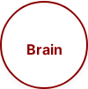
Orchestration: LangGraph Concept
•
Beyond Linear Chains: Replaces brittle DAGs (A → B → C) with robust cycles.
•
Cyclic Cognition: Loops enable human-like problem solving and re-visiting steps.
•
Self-Correction: If a step fails, the agent "loops back" to retry or adjust strategy.
•
Persistence: Maintains a global state object, accumulating context over time.
Cyclic Graph

Slide 3




Orchestration: Control Flow
•
Deterministic Control: Strictly enforces business logic using rigid nodes and edges.
•
Guardrails: Prevents unpredictability by forcing specific paths (Plan → Execute).
•
Human-in-the-Loop: "Interrupt" nodes pause execution for high-stakes approval.
•
Risk Mitigation: Limits hallucinations and prevents infinite reasoning loops.

Slide 4






Orchestration Ecosystem
•
Cognitive Core: LLM acts as the "Brain," deciding the next best action.
•
The Nervous System: The graph connects the brain to limbs (tools) and senses.
•
Dynamic Routing: Intelligently delegates tasks to specialized tools (Math, Search, Code).
•
Feedback Loops: Outputs from one tool become inputs for the next thought.

Slide 5
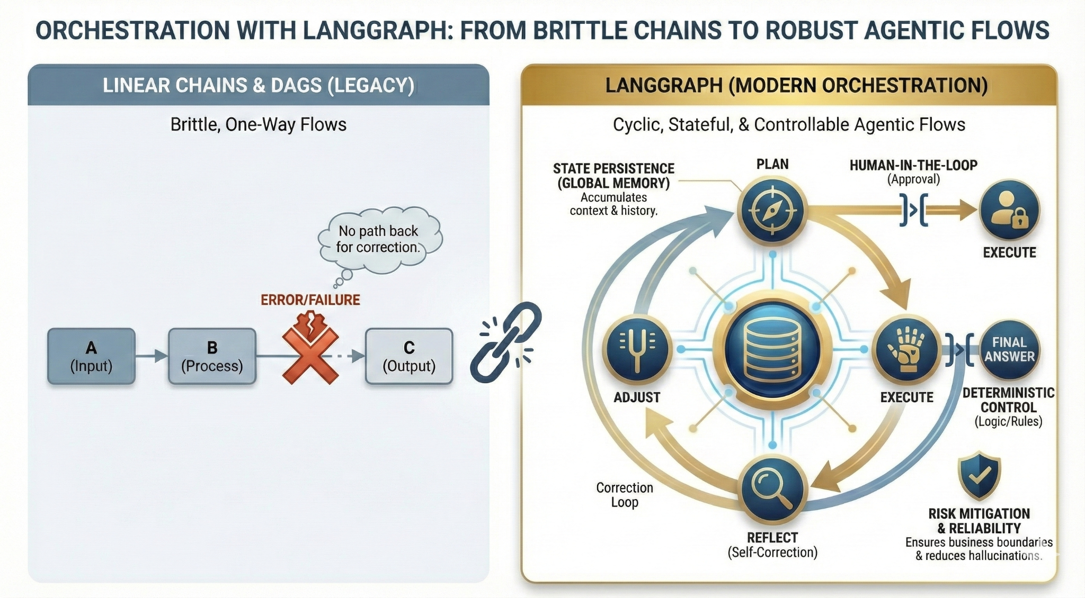

Slide 6




Stateful Financial Workflows
•
The Limitation: Standard APIs are stateless; no memory of previous steps.
•
Database-Backed Memory: Uses checkpointers to save graph state at every step.
•
Context Retention: Data extracted in Step 1 persists to inform Step 3.
•
"Time Travel": Allows developers to rewind, modify state, and fork execution for debugging.

Slide 7


Model Context Protocol (MCP)
•
Problem: N+1 Integrations. Custom "glue-code" is brittle and unscalable.
•
"USB-C for AI": A universal open standard for connecting models to data.
•
Decoupled: Separates the AI "Host" from the Data "Server."
MCP
•
Interoperable: Write once, connect to any MCP-compliant AI client.

Slide 8



MCP Technical Architecture
•
MCP Host: The interface (e.g., Claude Desktop, IDE) initiating the connection.
•
MCP Client: Negotiator layer. Handles protocol handshake and capabilities.
•
MCP Server: Lightweight wrapper exposing data/tools (e.g., Postgres wrapper).
•
Security: Explicitly defines resources, preventing unauthorized access.

Slide 9





Connectivity: Hub-and-Spoke
•
Hub-and-Spoke: Replaces messy "Mesh" integrations with a unified layer.
•
Complexity Reduction: Moves from N x M complexity to N + M.
•
Scalability: Adding one data source makes it available to all connected agents.
•
Portability: Swap LLM providers without rebuilding infrastructure.

Slide 10
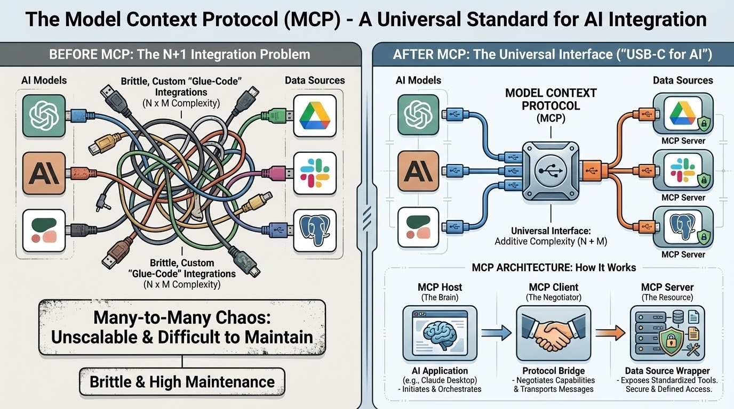

Slide 11



RAG: Retrieval Augmented Generation
•
Grounding: Forces AI to answer only based on trusted internal documents.
•
Semantic Search: Uses embeddings to find meaning, not just keyword matches.
•
Dynamic Knowledge: Instant access to new data without model fine-tuning.
•
Verification: Provides citations and source links for trust.

Slide 12


RAG Ingest Pipeline
•
ETL: Ingest raw data (PDF, SharePoint, Drive).
•
Chunking: Smart segmentation retains context for the LLM.
•
Embeddings: Converts text to high-dimensional vectors (numbers).
•
Vector Indexing: Enables millisecond "Nearest Neighbor" retrieval.

Slide 13
